Slide 1
Guidelines
Kindly use the given template for submitting your prototype(Make a copy of the template)
One team is only required to submit one project.
Follow this template while preparing your presentation.
You are welcome to add as many POCs and design concepts to support your project.
The project should be feasible and the team members should be capable enough, to come up with the fully functioning prototype of the same idea, if required.
In case of queries, kindly reach out to us at solutionchallengesupport@hack2skill.com
Note: Prototype must include cloud deployment and use at least one Google AI model or service (e.g., Gemini) as part of the solution.

Slide 2


Team Details
Team name: Infinity Stack
Team leader name: Jannat
Problem Statement: [Rapid Crisis Response] Accelerated Emergency Response and Crisis Coordination in Hospitality

Slide 3
Brief about your solution
CrisisGuard is an AI-powered emergency response system designed for hotels. It detects emergencies using smart inputs and instantly alerts hotel staff, emergency services, and guests to ensure faster and coordinated response.

Slide 4
Opportunities
How different is it from any of the other existing ideas?
• Uses AI instead of manual reporting
• Real-time automated alerts
• Enhances decision-making with intelligent insights and predictive analysis
2.How will it be able to solve the problem?
• Reduces response time
• Improves coordination
• Provides data-driven insights for faster and accurate actions
3.USP of the proposed solution
• AI-based detection + instant multi-user alerts + live dashboard + predictive
analytics

Slide 5
List of features offered by the solution
Emergency SOS button
AI-based emergency detection
Live dashboard for hotel staff
Location tracking inside hotel
Instant alerts to guests & staff
Cloud-based system

Slide 6
Process flow diagram or Use-case diagram
User/AI detects emergency
Data sent to cloud
AI processes using Google Gemini
Alert generated
Notification sent to staff + guests
Emergency handled

Slide 7
Wireframes/Mock diagrams of the proposed solution (optional)
Home Screen
SOS Button
Report Emergency
Alert Screen
Fire detected on Floor 2
Admin Dashboard
Live alerts
Status tracking

Slide 8
Architecture diagram of the proposed solution
Mobile App: The user interface and primary data entry point.
Cloud Server: The central hub for logic, routing, and processing.
AI Model (Gemini): The intelligence layer used for data analysis and decision-making.
Database: The storage layer for user data, logs, and historical records.
Visual Logic Flow
[ Mobile App ]- rightarrow [ Cloud Server ] leftrightarrow[ Database ]
downarrow
[ AI Model (Gemini) ] rightarrow[ Alerts ] rightarrow [ Users ]

Slide 9
Technologies to be used in the solution
Component Technology
Frontend HTML ReactBackend Firebase AI Google Gemini Cloud Google Cloud Database Firestore

Slide 10
Estimated implementation cost (optional)
Cloud: Free (trial)
Development: ₹0
Tools: Free

Slide 11
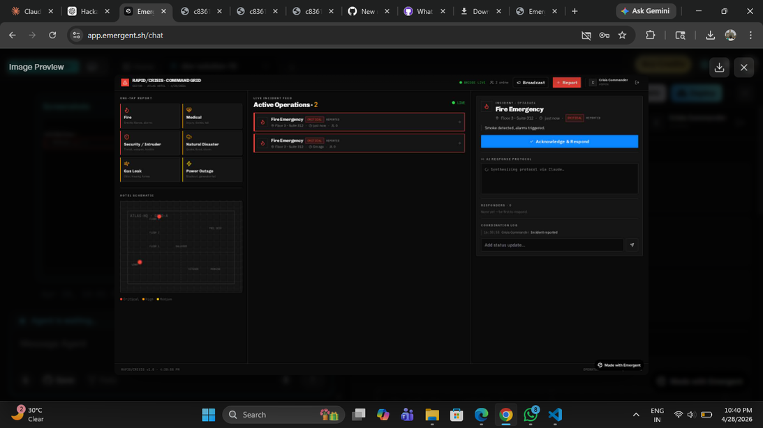
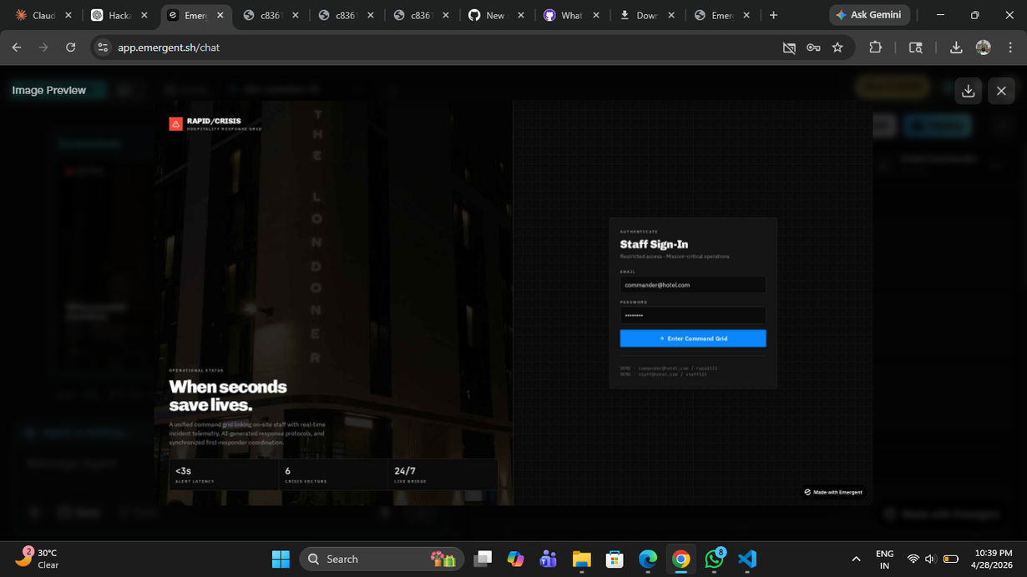
Snapshots of the MVP

Slide 12
Additional Details/Future Development (if any)
IoT sensors for fire/smoke detection: Expanding hardware capabilities to automate hazard detection without manual user input.
Integration with police/fire brigade: Establishing direct communication channels with emergency services for faster response times.
Voice-based emergency reporting: Implementing hands-free reporting to assist users in high-stress situations or those with limited mobility.
Multi-language support: Breaking down language barriers to ensure the system is accessible to a diverse, global user base.

Slide 13
Provide links to your:
GitHub Public Repository - https://github.com/srai95783-dev/Crisis- Guard/blame/main/README.md
Demo Video Link (3 Minutes)-"C:\Users\HP\Downloads\emergent-fullstack-app-and-3-more-pages-personal-microsoft-edge-2026-04-28_ixfSM73e.mp4"
3.MVP Link
Working Prototype Link

Slide 15


